Slide 1

21st century production analysis for 21st century wells
Christian Pierce
COO, Sales
cPierce@betazi.com
609-865-9597
Janette Conradson
CEO/CFO
Nimar S. Arora, PhD
Chief Science Officer
Heidi Anderson Kuzma, PhD
Chief Innovation Officer
10049 Martis Valley Rd.
Suite G Truckee
CA 96161
530-587-3858
Physics-based probabilistic inference for oil and gas.
Notes:
Introduction slide.

Slide 2
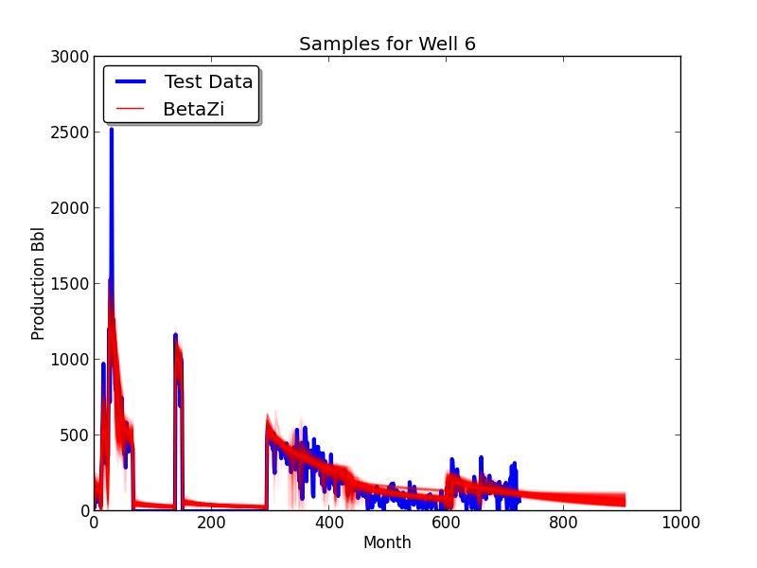
PATENT PENDING
Oil and gas production is risky.
Only BetaZi will tell you the odds.
BetaZi is a revolutionary new analysis package for accurate forecasting and optimization of production from oil and gas wells:
  particularly in unconventional plays
  for wells that have short production histories
  for which only noisy, aggregated data is available.
    FAST
    ACCURATE
    UNBIASED
    AUTOMATIC
    PHYSICS-BASED
    IDENTIFIES SHUT-INS AND STIMULATIONS
    QUANTIFIES UNCERTAINTY
Notes:
Data on this slide is from a group of conventional oil wells that are now almost in “stripper” mode (less than 100 bbl a day). BetaZi manages to fit the curve despite a very complicated production history. Each of the thousand transparent red lines is a separate BetaZi “sample” – that is, a possible answer. There is a high probability of those answers being correct where all of the red lines add up to make a thick red line. Notice that when we project them forward 15 years, they start to spread out, indicating uncertainty in our forecast. It is this ability to deal correctly with uncertainty that makes us different from every other product on the market.

Slide 3
What BetaZi Does
Input the production history of a well and BetaZi will find a million scenarios which explain the data with high probability and which can be projected forward to estimate:
EUR
NPV
History of well
Effect of stimulation and shut-ins
Notes:
When we project those million samples forward, we come up with not just one number for Estimated Ultimate Recovery (EUR) and Net Present Value (NPV), but a correct assessment of uncertainty as well. As a consequence of the sophistication of our model, we are also able to explain the history of a well and predict the effect of stimulation and shut-ins accurately.

Slide 4
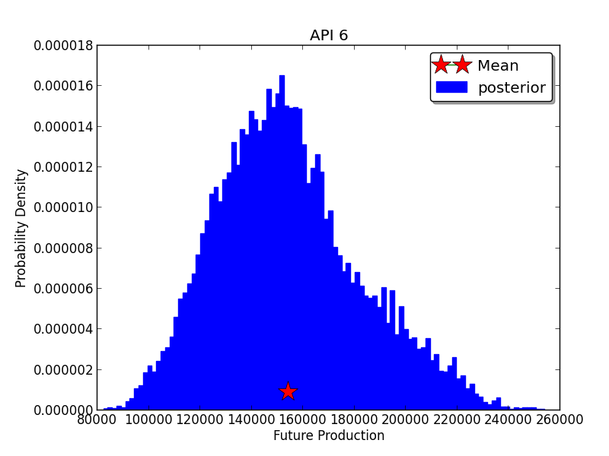
Why the Need for BetaZi?
Trillions of dollars are exchanged globally based on production projections of oil and gas wells made by petroleum engineers and financial analysts – effectively by hand.
A single analysis can take a petroleum engineers hours or days.
Forecasts can be biased by the opinion and objectives of the person who made them.
BetaZi is
  Automatic
  Unbiased
  Transparent
  Repeatable
  Fast
  Honest
BetaZi returns histograms showing the distribution of possible future production scenarios.
Notes:
BetaZi returns a histogram showing the possible distribution of EUR or NPV. If you are making such a projection by hand, then you only get one point in this histogram. Current software and practice makes it very easy to pick out which point that will be. An engineer might come up with a low or high number which appears reasonable. Without seeing the full histogram, a decision-maker has no way to assess the actual truth (or probability) of that number. There are many examples of deals going sour because a third party evaluator picked a number that was unreasonably low or high.

Slide 5
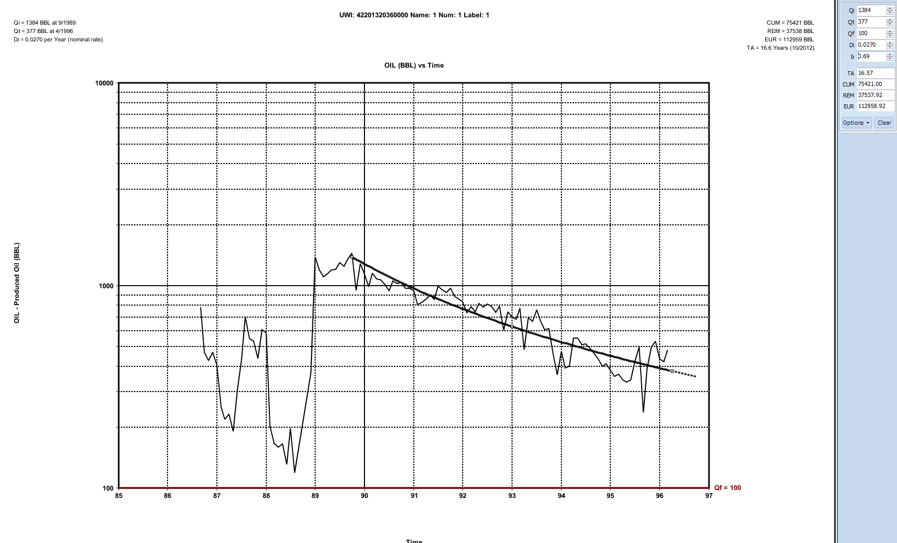
Currently, production forecasts are made by hand
EUR = 112,959 BBL oil
Lifetime = 16 years
Small differences in early curve fitting add up to huge discrepancies when projected forward, because errors accumulate.
Notes:
This is an example of how numbers can be adjusted. This is a screenshot from a popular package. The user selects the data to be fit (note that it is not easy to pick the point where the curve will start). An automatic curve is fit. A grabber-tool allows the user to adjust it. EUR and well lifetime numbers are displayed in the upper corner of the graph and adjust along with the curve.
The data in this example is from a conventional oil well.

Slide 6
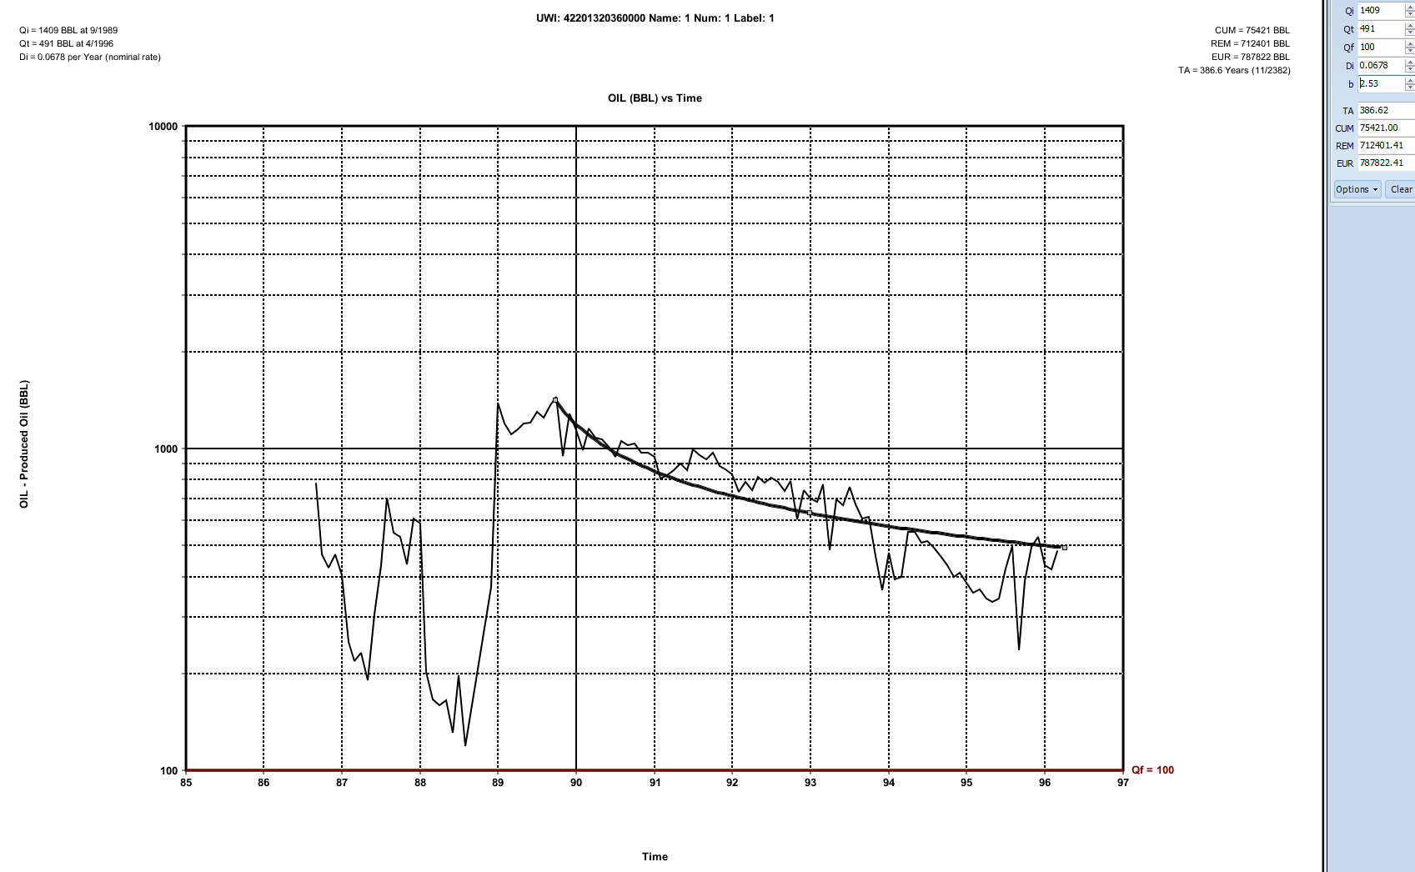
Current ‘State of the Art’ production forecasting is set by hand
EUR = 787,822 BBL oil
Lifetime = 386 years
A curve adjustment increases the value of this well by 674 k BBL. Curve fitting can introduce as much risk into a project as fluctuations in price per BBL or Mcf.
Notes:
By moving the curve up, EUR can be increased by a factor of seven and the lifetime of the well increases over 350 years! This information now becomes the base of the reserves estimate computed by the rest of the software package. Effectively, reserves can be taylor-made to any desired number using this technique.
Note: To get an analysis done like this by a professional petroleum engineer can cost anywhere between $5000 - $30,000 per well.

Slide 7
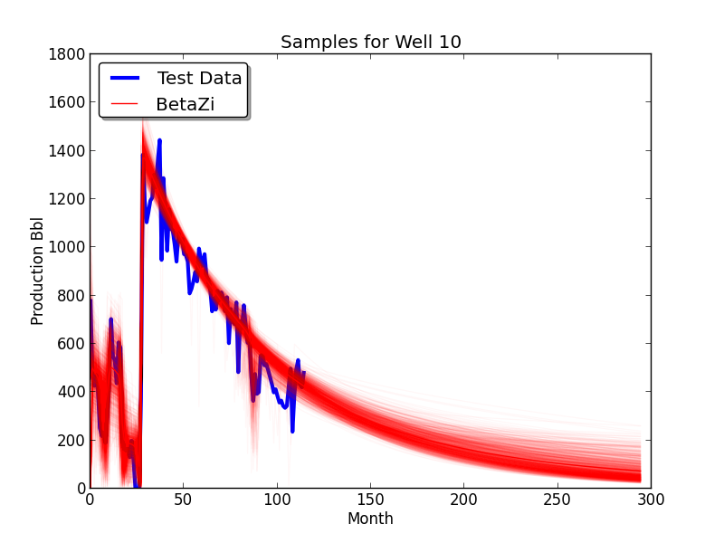
BetaZi Projections
Instead of just producing one curve, BetaZi returns a million possible curves which can be used to compute statistics on future production. Automatically! On this well it correctly determines when to start the production decline.
Production “Events” are captured by BetaZi
Each curve represents a high probability “hypothesis.”
Notes:
BetaZi keeps you honest. Using the same data, instead of one curve, we return all of the curves that fit the data (with high probability).

Slide 8
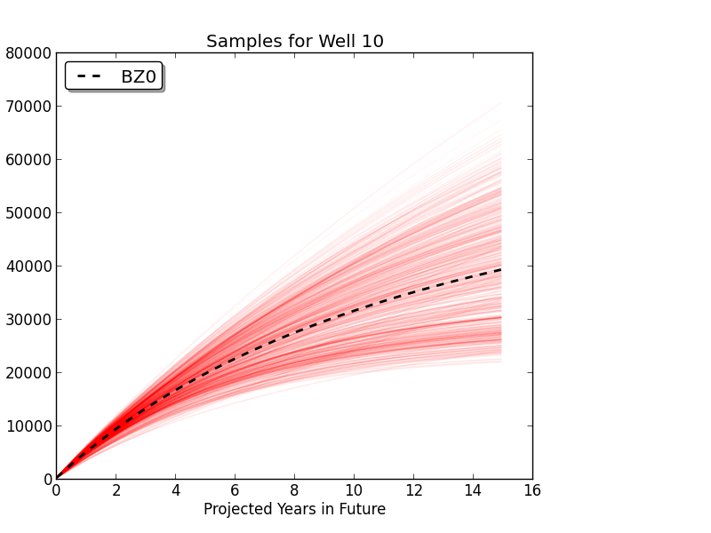
Future production cumulative
Our samples are projected forward to predict future production trajectories and establish confidence intervals. With 95% confidence, future production will exceed the “BZ.”
Expected Production
BZ
In this case, the difference between a high and low projection is over 50,000 BBL with a Net Present Value (NPV) of more than 4 million dollars.
Notes:
The BZ is also the 5th percentile. NPV was computed using 10% discount rate and no Operating Expenditures.

Slide 9
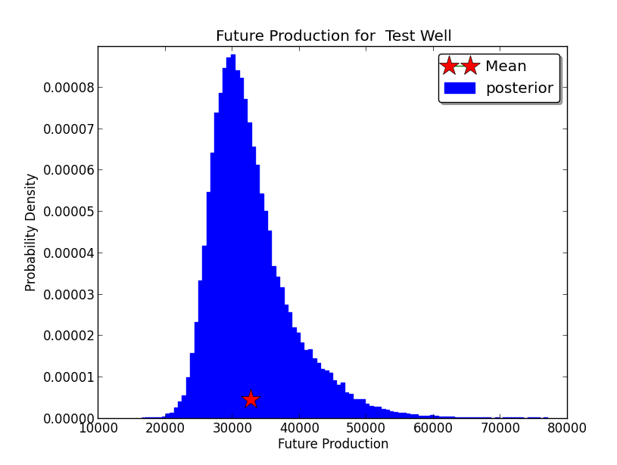
What’s the BZ?
BZ = 28,000 bbl
BZ @ 65 = 30,000
Expected = 31,000
With 95% confidence, future production in the next 15 years will exceed the BZ
With 65% confidence, future production will exceed the BZ @ 65.
Notes:
Remember, you only get one number out of the commercial package – the person who did this analysis could have picked out anything 20,000 BBL and 60,000 BBL – increasing reserves by a factor of 3. The well could have those production numbers – but with low probability. One of the reasons to run BetaZi is to evaluate the probability of the answers your experts are giving you.

Slide 10
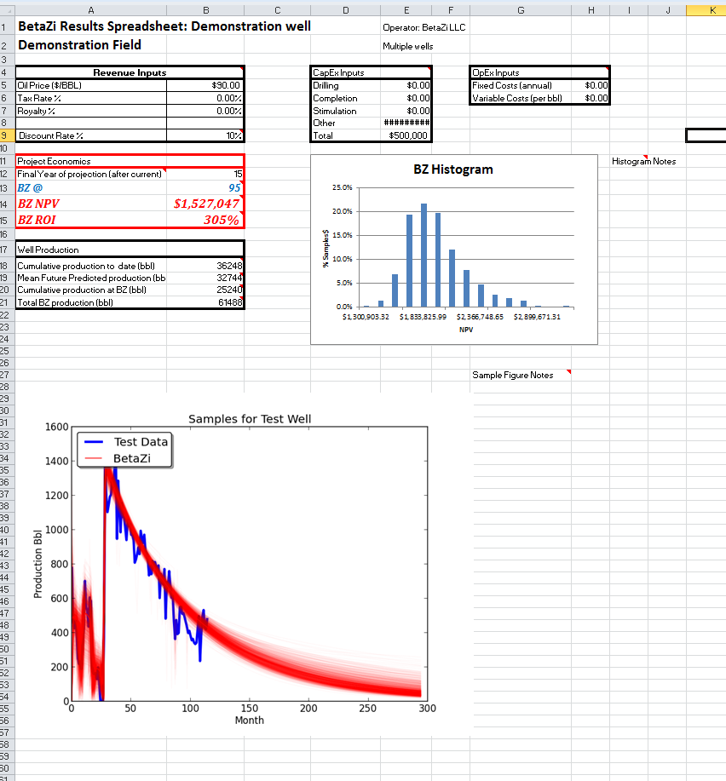
Results are output to an interactive spreadsheet for financial analysis of a well
Notes:
This spreadsheet can be customized to meet a customer’s needs. Soon to be added will be EUR and well lifetime as well as a feature to factor in enhanced recovery.

Slide 11
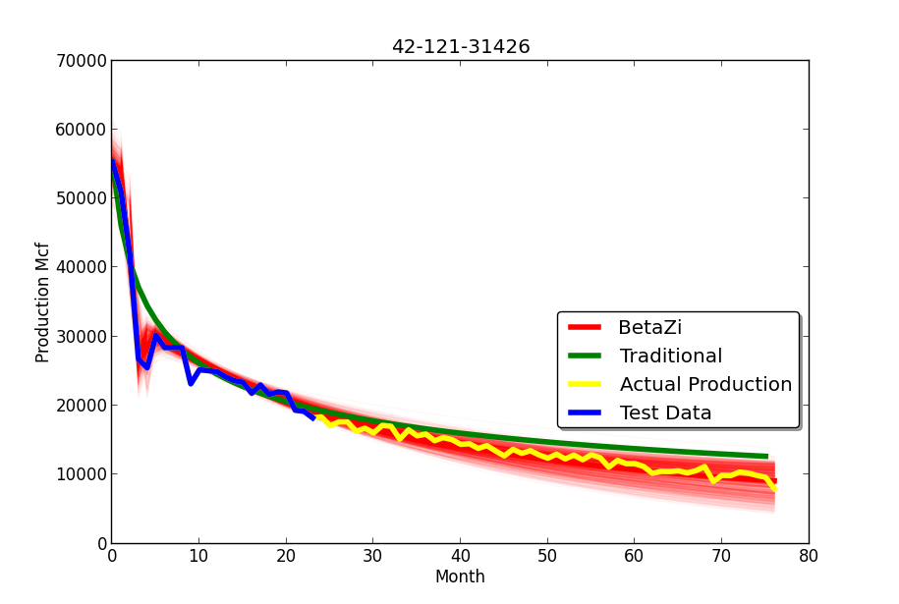
BetaZi compared to an “Expert”
(Expert starts low and predicts high)
Notes:
We asked an industry leader to make projections using 24 months of data from 12 shale gas wells. (We had 1000 wells, but we could only ask for 12 because it would have taken him too long to do more). We then compared his projections to the BetaZi projection and actual production. He was an admitted “pessimist” so most of the time he projected low. In this example, his projection fits the data low but then curves up.

Slide 12
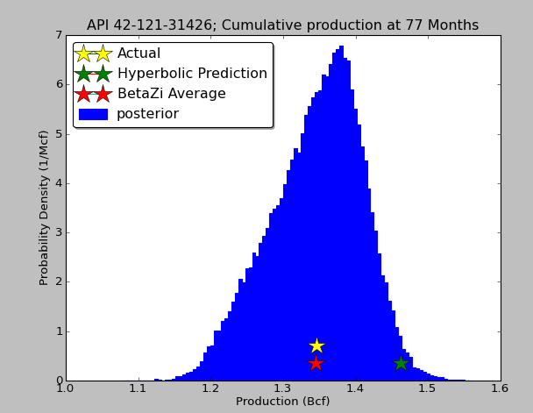
BetaZi compared to an “Expert”
Actual production
BetaZi Mean
“Expert” prediction
BZ
Notes:
BetaZi production histogram compared to the expert and to actual production. This slide should speak for itself.
As an aside: note that the distribution does not have the shape of an exact bell curve. Most packages will assign error bars to projections assuming a Gaussian distribution (bell curve), but in reality that is rarely the case.

Slide 13
Average results for 12 wells (5 year forecast)
Expert prediction compared to BetaZi mean
 | Expert | BetaZi
Mean absolute error (Bcf) | -0.06 | -0.01
Root Mean Squared Error (Bcf) | 0.11 | 0.07
Cumulative error ($) Gas at $4 mcf | -2.7 mil | -0.6 mil
Ratio of Expert/BetaZi RMSE = 1.6
Notes:
True to his word, the Expert was a pessimist. Many deals do not go through because a third party evaluator gives a production estimate which is too low for financing to be secured.

Slide 14
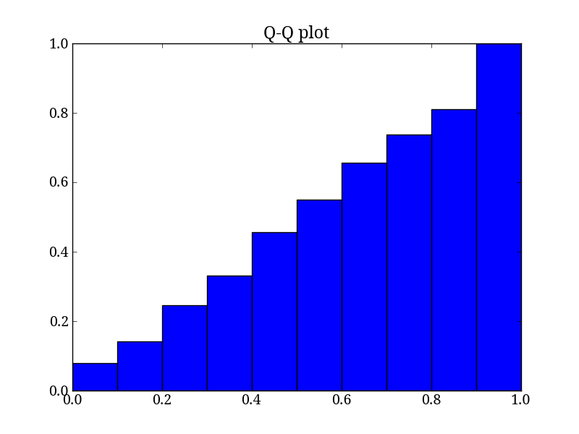
Percentile Accuracy Test proves our confidence intervals are correct
78% of actual wells produced more than their BZ@ 80
Straight line at 45% indicates that BZ confidence matches reality
% of 1000 actual wells that produced above the BZ
BZ
Notes:
This slide is pretty technical. The BetaZi staff can explain it in detail.

Slide 15
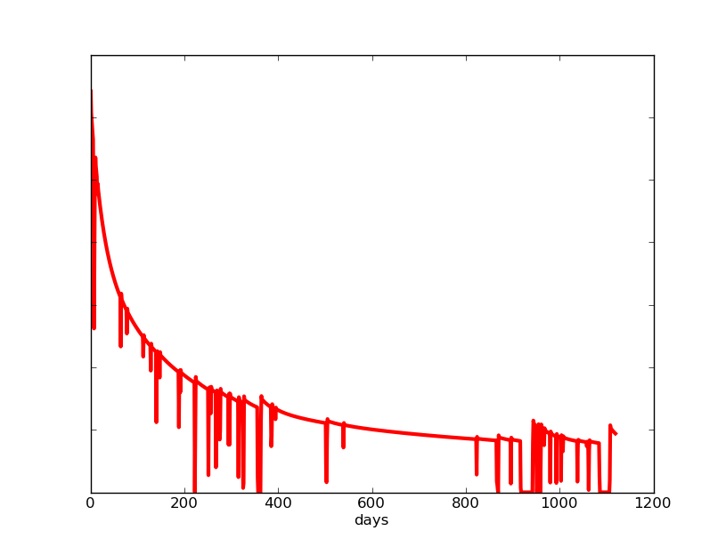
BetaZi Analysis is a newly calibrated multiphase model for daily oil, gas, water and pressure data
Input was only monthly oil or gas production for previous slides.
Can also input daily production data with pressure, multiphase production, shut-in hours in which case output includes:
  Production Projection
  Behavior during simulation and shut-ins
  Coefficients which track production regimes
Notes:
By including more information (pressure, shut-in hours), we can make a much richer model. This is one sample from an analysis of a shale gas well. We cannot show the data because it was proprietary.

Slide 16
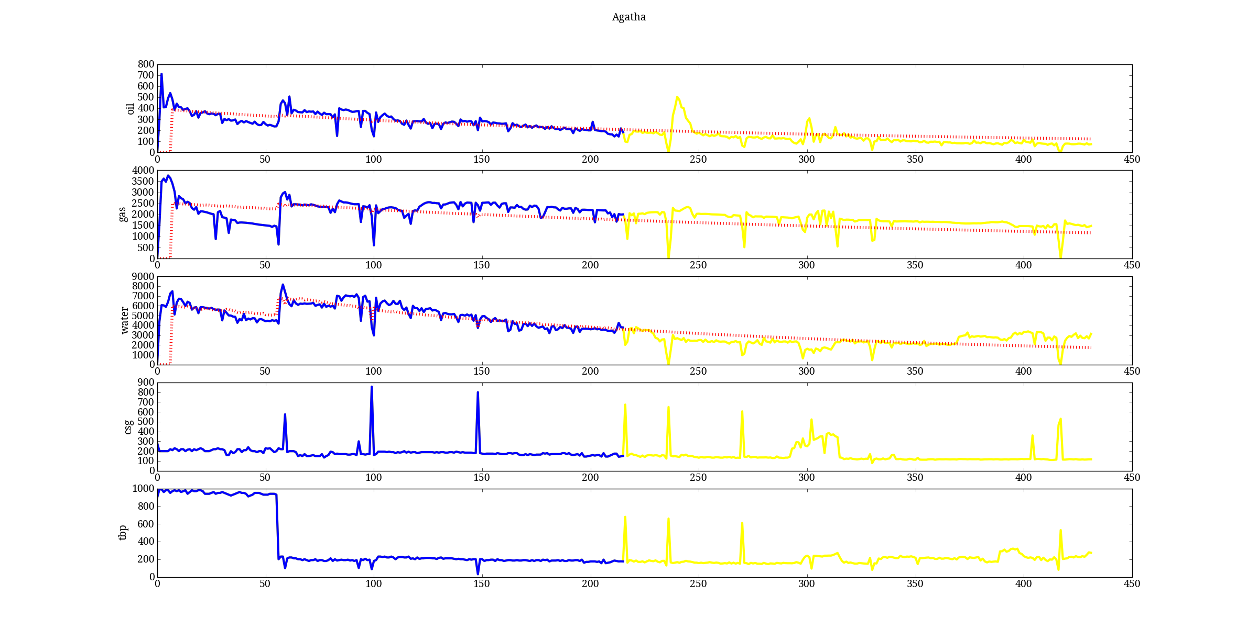
Hot off the press!
Pressure
gal/day

Slide 17
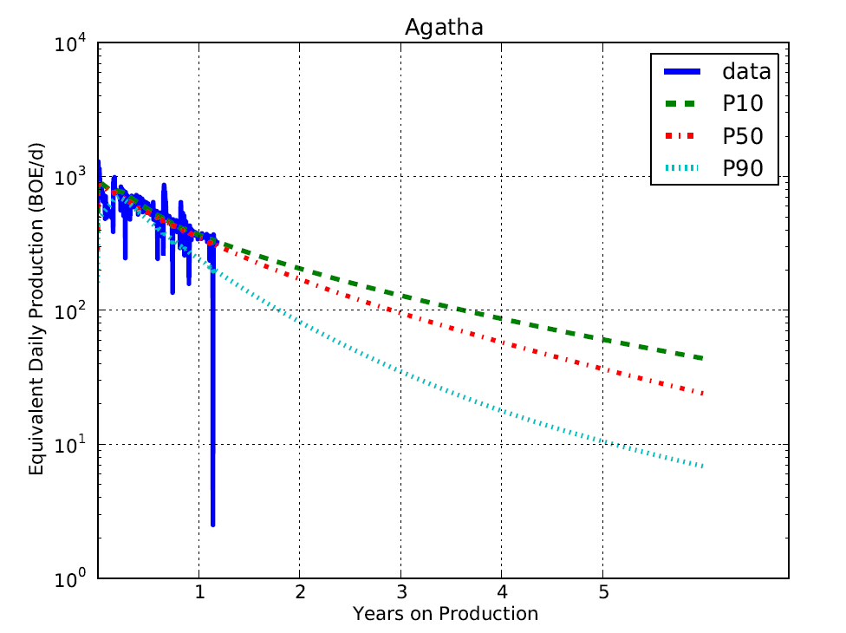
Projection based on Analysis model used to forecast production

Slide 18
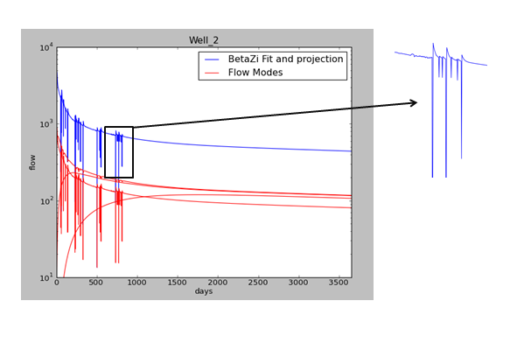
Daily coefficients track production regimes and predict anomalous production after shut-ins
Notes:
The original motivation for building BetaZi was an observation that the anomalous production following a shut-in often produces an amount of gas that exceeds the production lost during the shut-in. With this kind of information, it may be possible to “pump” wells by shutting them in for short periods. It might be further possible to increase revenues from a well by optimizing production as a function of the price of gas, i.e. pump the well when the price is going up and let it ride when the price is down. This is impossible right now because not even high end numerical modeling software can capture this behavior.

Slide 19
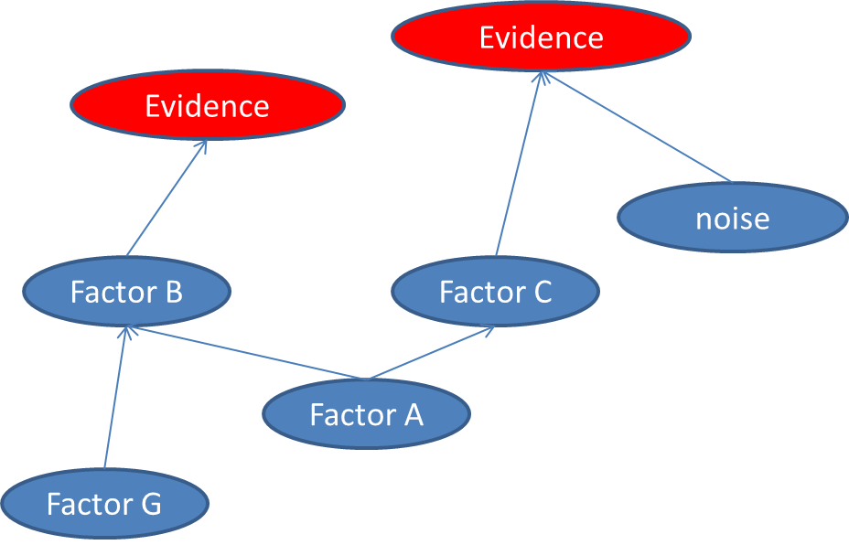
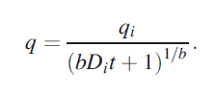
How Do We Do it?
(probabilistic inference)
y = F (x)
Production
Well (rocks, hardware, operations)
US
THEM
Instead of using a fixed function to describe well decline (such as the Arps equation), BetaZi uses a probabilistic Knowledge Representation that combines physics with statistics and experience.
Fixed equation + (maybe) uncertainty on x and y.
Every part of the equation is flexible.
In addition, BetaZi is:
Well Parameterized
  The exact right number of variables are used: not too few (simplified curves); not too many (high end numerical models).
Well Calibrated
  When probability distributions are used, they are determined precisely by expert statisticians using real oil and gas data.
Notes:
Again – address inquiries to the BetaZi scientific staff!

Slide 20
BetaZi Product Offerings
BZ ECONOMETICS
Forecasts production from monthly production data
Designed for decision-makers
Estimated Ultimate Recovery
Short/long term production forecasts
Well valuation
SEC reporting
Charged on a per well basis
READY NOW
BetaZi ANALYSIS
Analysis of daily production, pressure and shut in data
Designed for engineers
Detailed forecasting
Analysis of stimulation and shut in behavior
Identification of flow regimes
Exclusive License or Purchase
DEVELOPED
Initial testing and model calibration complete
BetaZi CUSTOM
Inclusion of any desired factor
Customized for specific problems
Multiple horizons
Time-dependent permeability
Customized warnings
Aggregated production data from multiple wells
Exclusive License or Purchase
Our products can be customized for any particular market or customer.
Notes:
We seek customers and partners!

Slide 21
End of Slides
Thank you!
http://www.betazi.com
(new website: static pages go live today)
See our other projects at
http://www.chatelet-resources.com

Slide 22
Glossary of terms
  BZ – What’s the BZ? The BZ is the minimum projected production or financial return expressed as Net Present Value (NPV) that can be expected from a well with 95% probability. It is the 5th percentile of the BetaZi samples.
  BZ @ 65 – Is the minimum projected production or return that can be expected with 65% probability. The number can be dialed to reflect an investor’s risk tolerance.
  Decline – the tendency of a well to produce less and less over time (generally following a roughly exponential curve).
  Decline Curve Model – the simple mathematical equations used describe well decline. These include exponential, hyperbolic, elliptical and Arps decline models.
  Decline Parameters – the variables in these equations which describe the exact path of the curve as a function of time. The goal of traditional decline analysis is to find these parameters so that they can be projected forward.
  Calibration – the process of using real data to find optimal general parameters for probability distributions in a Generative Model.
  Econometrics – the explicit mathematical study of instruments which generate revenue.
  Generative Model – a statistical model which can be used either to evaluate the probability of a particular production scenario given data that has been measured or to draw samples which explain the data with high probability.
  Net Present Value (NPV) – the discounted total value of an investment which makes monthly or yearly payments.
  Probabilistic Inference – The process of finding high probability samples which explain a data set. BetaZi is composed of a Generative Model and an Inference Algorithm.
  Parameterized – the particular set of variables in an equation which are used to describe a physical or statistical relationship. BetaZi is Well Parameterized which means that it uses an optimal number of variables, enough to capture the richness of well dynamics but not so many that a solution cannot be found.
  Probability Distribution – a description (usually and equation) that tells how samples can be drawn at random which match the frequencies with which they are observed in nature.
  Risk – the probability that an investment or project will lose money.
  Shut in – a period of time during which a well is not producing because the choke which controls flow has been shut off. This is done regularly for maintenance, testing and due to unforeseen circumstances.
  Statistics – the science of discovering probability distributions from data
  Stimulation – a well treatment such as hydraulic fracturing done to increase production from a well.
Notes:
Please add as needed

Slide 23
From the SPE Discussion group pipeline 3.7.13
BetaZi is the Technology that Engineers want
and the Industry needs:
(John Thompson from Fekete as quoted on LinkedIn by amy.miller@hansonwade.com)
Quote 1:
“If you use expected values, or averages of uncertain input variables, you sometimes don’t come out with the expected output from a model. The human mind can not easily wrap around statistics. It was surprising for me to learn that if I use the best number I have for each parameter in the model, I don’t get the expected outcome.”
BZ Answer: Setting up a probabilistic model is easy. Setting up one where the outcome (the final) is right is hard. You have to have a realistic physical model, an excellent understanding of uncertainty and statistics, and know how to test it. This is what we mean when we say BetaZi is “well calibrated.”
When we say that BetaZi is the next generation –
this is EXACTLY what we mean

Slide 24
Quote 2:
“Numerical modeling is intended to be the ‘Cadillac’ of solutions as they would say. But simulation is a: optimistic and b: time consuming and it does not provide a practical workflow for engineers because they can’t do this on all of their wells, there is not enough time in the world to do this. So we know we can't do it and so we use an analytical workflow which takes a fraction of the time… maybe 1/10th of the time… and you can use it to generate stochastic output. Practically speaking, probabilistic modeling is not possible with numerical models.”
BZ Answers: The "secret sauce" of BetaZi is that it is a numerical model that is well-parameterized. It has just the right number of variables: not so many as in high end numerical models, and not too few as in simplified curves. We can get away with baskets of variables because the interactions between them are described probabilistically: we know how to integrate statistics carefully into the physics of fluid flow. This means that our models are not only rich enough to capture the real behavior of wells, but they are solvable in reasonable time.
We have solved the problem

Slide 25
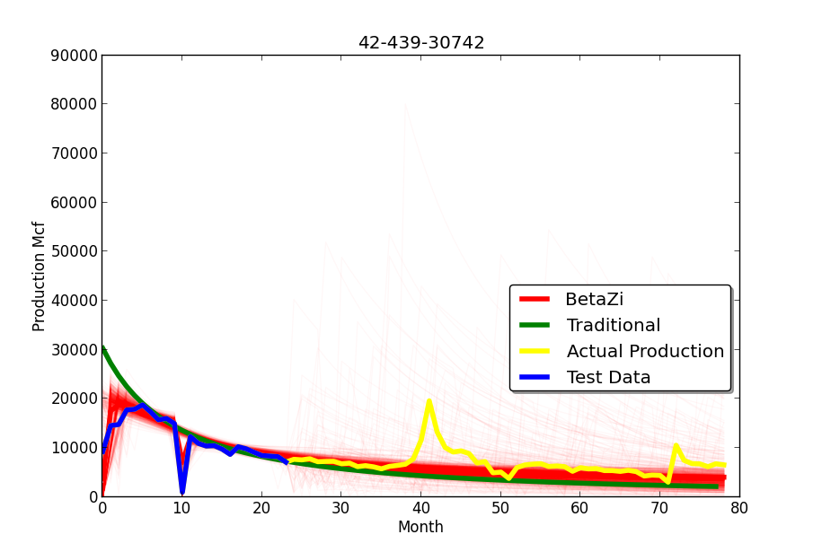
Example of BetaZi predicting a stimulation
Notes:
The “stimulation” simulation after the end of production records is optional.

